Slide 1
Introduction to Design Patterns & Principles

Slide 2
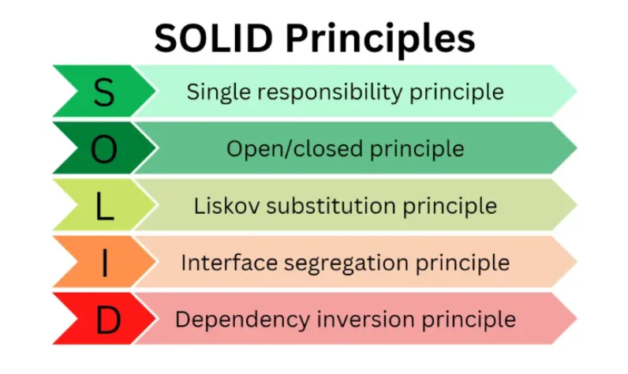

Slide 3
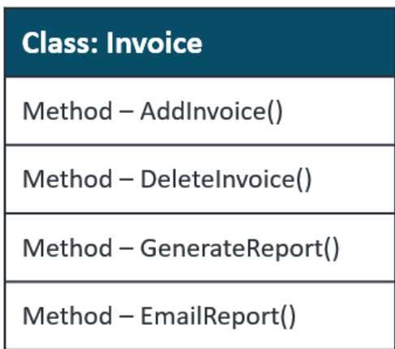
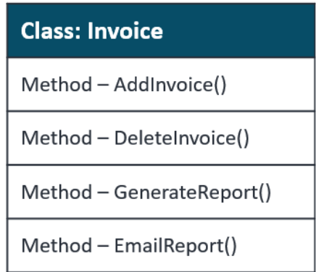
Single RESPONSIBILITY PRINCIPLE
A class in object-oriented programming should have only one reason to change

Slide 4
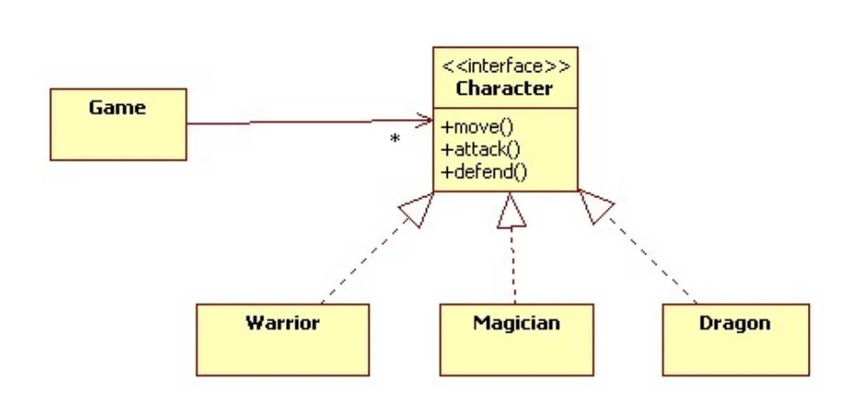
Open/Closed Principle (OCP)
Software entities (like classes, modules, functions) should be "open for extension,
but closed for modification," .

Slide 5
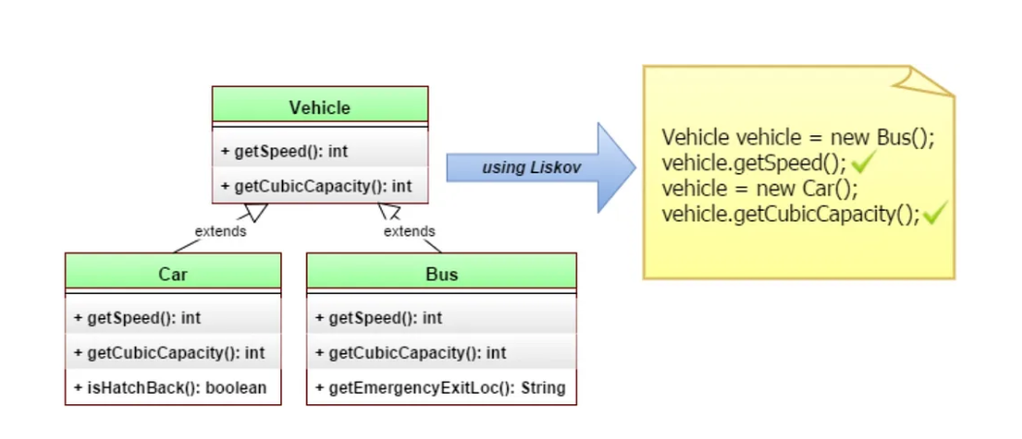
Liskov Substitution Principle (LSP)
Objects of a superclass shall be replaceable with objects of its subclasses without
breaking the application.

Slide 6
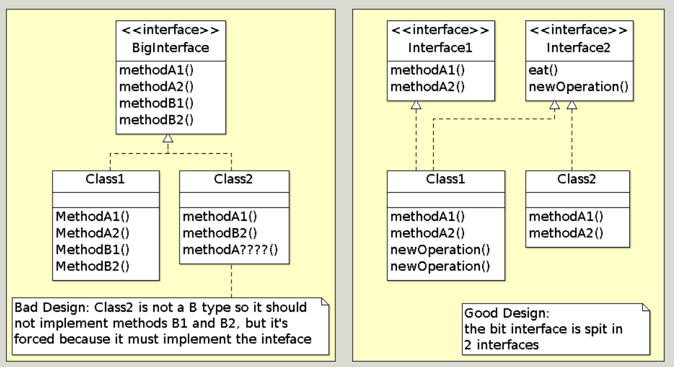
Interface Segregation Principle (ISP)
Clients should not be forced to depend on interfaces (methods) they do not use.

Slide 7
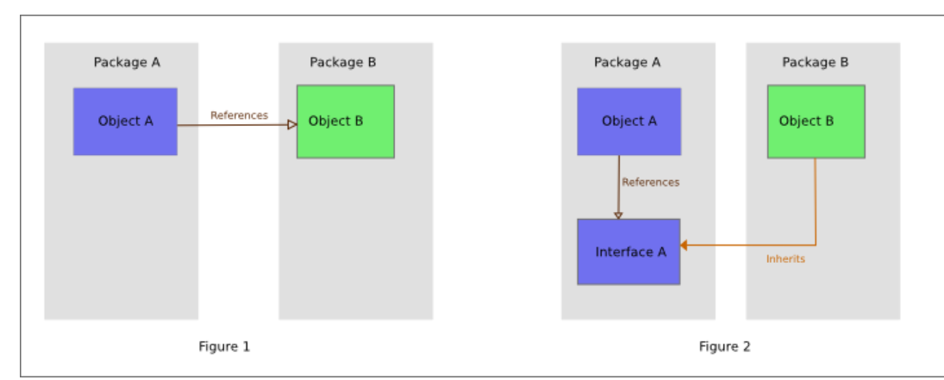
Dependency Inversion Principle (DIP)
Dependency Inversion is the strategy of depending upon
interfaces or abstract functions and classes rather than upon concrete
functions and classes.

Slide 8
Design patterns
Idea: extract these common patterns and create a catalog of design patterns
allows other designers to reuse successful designs and avoid unsuccessful ones
creates a common vocabulary for discussing designs
1995: Design Patterns book by the Gang of Four (Gamma, Helm, Johnson, Vlissides)
describes 21 common patterns

Slide 9
Motivation
Designing reusable software is hard
usually impossible to get right the first time
takes several uses of a design to get it right
Experts base new designs on prior experience
In many systems, you find recurring patterns of software components
classes, protocols, etc.

Slide 10
What is a design pattern?
A pattern has four components:
A name
A problem
A solution
Consequences

Slide 11
Name
Immediately allows you to design at a higher level of abstraction
Allows you to discuss the pattern with others

Slide 12
Problem
What problem does the pattern solve?
When do you apply the pattern?

Slide 13
Solution
Elements that make up the design
Relationships, responsibilities, collaborations
NOT a particular concrete design or implementation
A pattern is a template that can be applied in many different situations

Slide 14
Consequences
Results and trade-offs of applying the pattern
Impact on system's flexibility, extensibility, portability

Slide 15
What is not a design pattern?
A design of a data structure
A domain-specific design
A design of an entire application
A design used only once
A design pattern should capture mature, proven practices

Slide 16
Classifying design patterns
GoF identified two criteria for classifying design patterns
Purpose
Scope

Slide 17
Purpose
Creational patterns
describe how objects are created
Structural patterns
describe the composition of classes or objects
Behavioral patterns
describe the interaction of classes or objects and how responsibility is distributed

Slide 18
Scope
Class patterns
Deal with relationships between classes and their subclasses
Object patterns
Deal with relationships between objects
Relationships can change at run-time and are thus more dynamic

Slide 19
Before Patterns: Motorola
Factors preventing software reuse
Strong coupling of classes/objects
Short-term needs superseded longer-term
Architecture specifications suffered from
Ambiguity and lack of precision in the specs
Differing terminology
No direct access to the architects

Slide 20
Review of OO concepts
OO programs are made up of objects
An object packages both data and operations on that data
An object's operations are called methods
An object's implementation is defined by its class
New classes can be defined using existing classes through inheritance

Slide 21
Encapsulation
In pure OO: method invocations (messages) are the only way an object can execute an operation
The object's internal state is encapsulated
Encapsulation is often violated for efficiency

Slide 22
Polymorphism
Different objects can handle identical messages with different implementations
Dynamic binding: Run-time association of a message to an object and one of the object's operations
Can substitute objects that implement the same interface at run-time

Slide 23
Inheritance
There is a distinction between an object's class and its type
Class defines how an object is implemented
Type defines the object's interface
Java thus defines two forms of inheritance
Implementation inheritance
Ex: class B extends A { m() {} }
Interface inheritance
Ex: class C implements I { m() {} }

Slide 24
Reuse through subclassing
Easier to modify the implementation being reused
But, breaks encapsulation
Implementation of the subclass bound to that of the parent
any change to the parent requires change to the subclass
Must reimplement parent if any aspect of the its implementation is not appropriate to the new context in which it is used

Slide 25
Reuse through composition (1)
Requires carefully designed interfaces
Doesn’t break encapsulation
Any object can be replaced by another at run-time if it implements the same interface
Fewer implementation dependencies
Helps design
keeping each class encapsulated forces you to keep classes simple

Slide 26
Reuse through composition (2)
But, composition leads to more objects in the system
Behavior depends on interrelationships between many objects not on one class

Slide 27
GoF’s Principles of OO design
Program to an interface, not an implementation
Favor composition over inheritance
Ideally, get all the functionality you need by composing existing components
In practice, available components aren’t rich enough
Reuse by inheritance easier to create new components that can be composed of old ones

Slide 28
Summary
Patterns
are a good team communication medium
are extracted from working designs
capture the essential parts of a design in compact form
can be used to record and encourage the reuse of "best practices"
are not necessarily object-oriented

Slide 29
Creational and Structural Patterns
Creational
Encapsulate knowledge about which concrete classes the system uses
Hide how instances of these classes are created and put together
Examples: Singleton, Abstract Factory

Slide 30
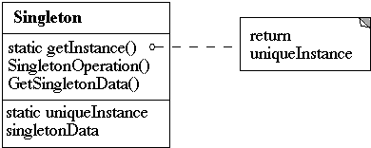
Singleton
Intent – Ensure a class has only one instance and provide a global point of access
Motivation
Some classes need exactly one instance
One window manager, one file system, one print spooler
Need global access, but global variable does not prevent multiple instantiation
Have class keep track of it’s sole instance

Slide 31
Singleton (2)
Applicability
There must be exactly one instance of a class and it must be accessible to multiple clients
The sole instance should be extensible by subclassing, and clients should be able to use subclass without modifying code
Consequences
Controlled access to sole instance
Reduced name space (over global variable)
Extendable implementation
Permits a variable number of instances – (easy to change if don’t want singleton)
More flexible than static member functions – allows subclassing and easy to change to multiple number of instances

Slide 32
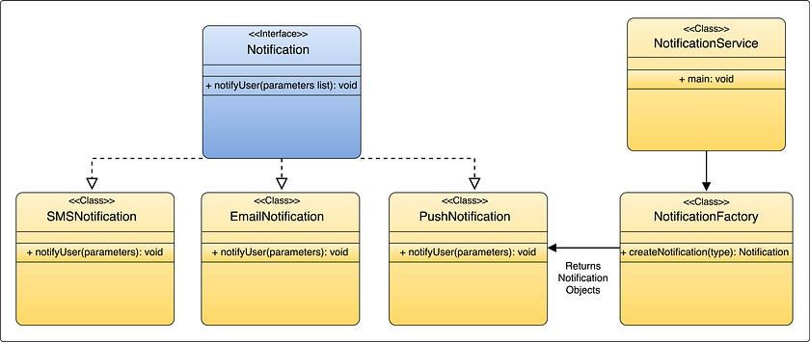
Factory
Intent - Provide an interface for creating objects, but let subclasses decide which class to instantiate.
Example of Factory Method

Slide 33
Builder
Intent – Separate the construction of a complex object from its representation so that the same construction process can create different representations.

Slide 34
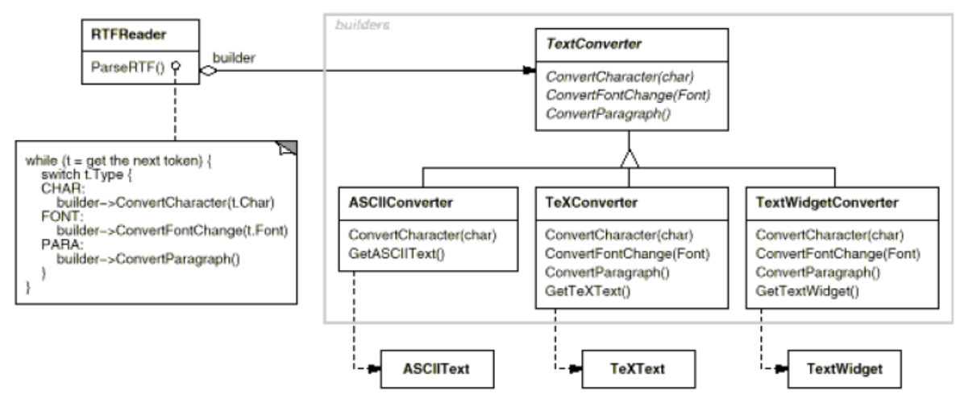
Builder

Slide 35
Structural Patterns
Structural
Describe how classes and objects are composed into larger structures
Examples: Proxy, Façade, Composite

Slide 36
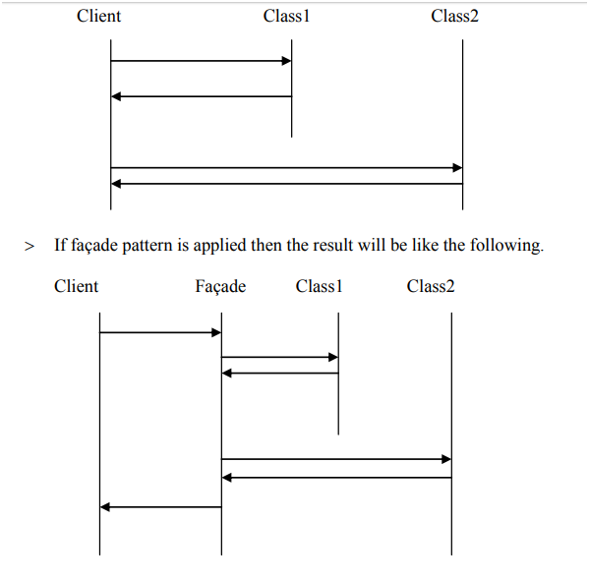
FacADE
Intent –The intent of the Facade pattern is to provide an interface that makes a
subsystem easy to use.

Slide 37
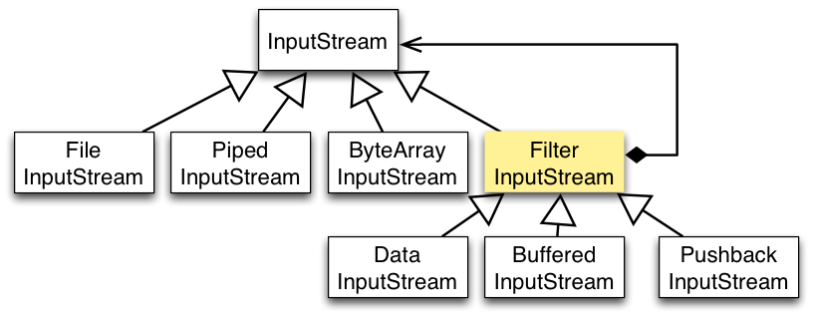
Decorator
Intent – Dynamically add new functionalities or behaviors to an object
without modifying its underlying structure or affecting other instances of the
same class.

Slide 38
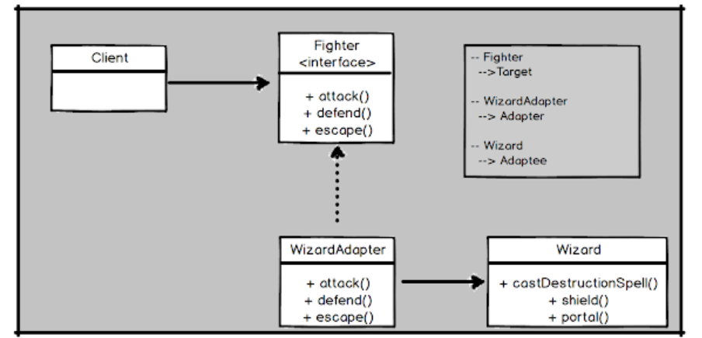
ADAPTER
Intent – Converts the interface of a class into another interface that clients expect,
enabling compatibility.

Slide 39
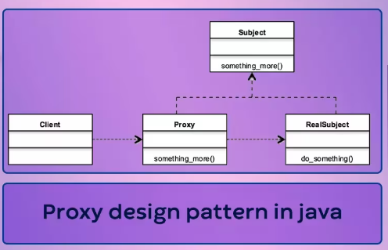
PROXY
Intent – Provides a surrogate or placeholder to effectively control access to an object,
enhancing security and resource management.

Slide 40
BEHAVIOURAL Patterns
Behavioural
Focus on the interactions and communication between objects
Examples: Strategy, Command, Visitor

Slide 41
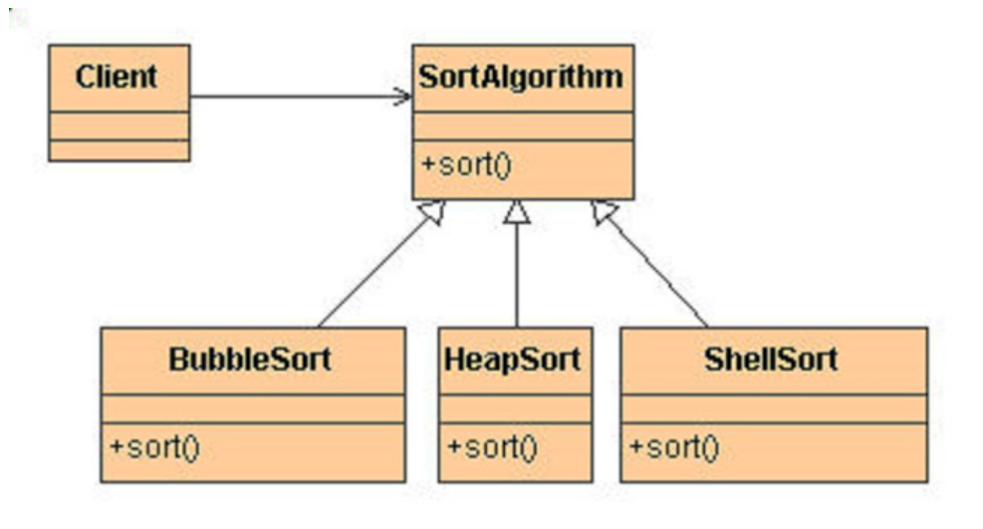
Strategy
Intent – Define a family of algorithms, encapsulate each one, and make them
interchangeable.

Slide 42
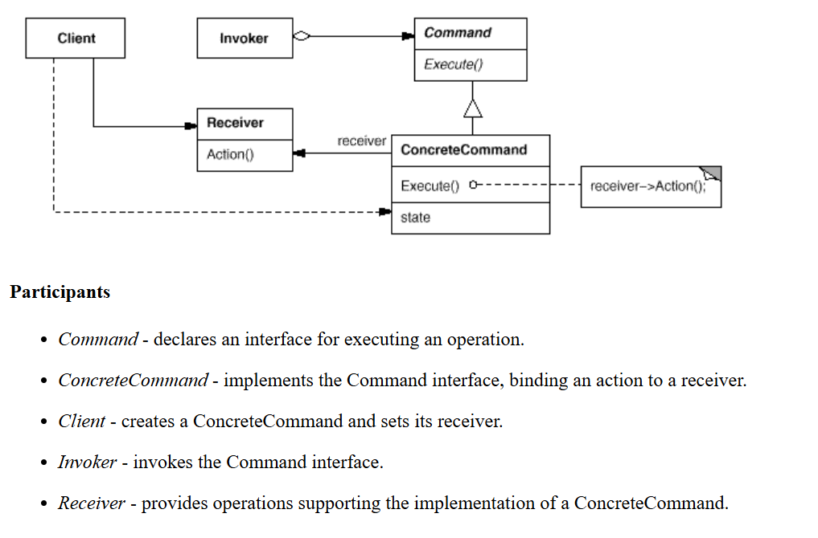
COMMAND
Intent – Encapsulates a request as an object, allowing for parameterization of
clients with queues, requests, and operations.

Slide 43
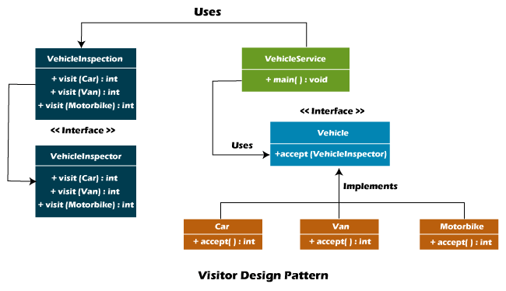
Visitor
Intent – Allows adding new behaviors to existing class hierarchy without altering any existing code

Slide 44
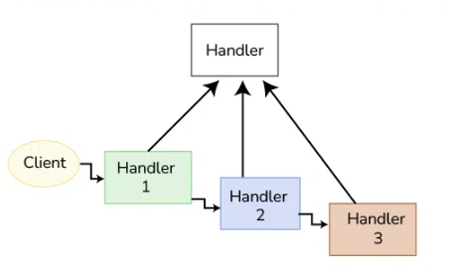
CHAIN OF ReSPONSIBILITY
Intent – Decouples the sender of a request from its receivers by giving more than one object a chance to handle the request.

Slide 45
References
Design Patterns: Elements of Reusable Object-Oriented Software, Gamma, Helm, Johnson, Vlissides, Addison Wesley, 1995, pp 207-217

